Slide 1
Social Psychology-Lecture 2:
History, Methods, and Theory
History of Social Psychology
  Key Events
  Trends
Research Methods
  Nonexperimental
  Experimental
  Quasiexperimental
Theoretical Perspectives
  Learning
  Consistency/Balance
  Attribution
  Exchange/Equity

Slide 2
Social Psychology-Lecture 2
“Man is by nature a social animal…”
(Aristotle, Politics, c. 328 B. C.)

Slide 3
Social Psychology-Lecture 2:
Trends in Social Psychology
Changes in focus (instinct, attitude, consistency, attributions, social cognition, automatic processing, neuro, culture, best research practices)
Changes in issues (prejudice, aggression, riots, crime, multiculturalism, morality, religion)
Changes in participants (gender, M to F, general to college students, MTurkers)
Changes in analysis (Univariate, Multivariate, Mediation)

Slide 4
Social Psychology-Lecture 2
Social Cognition: how individuals make sense of themselves and other individuals.
Social Neuroscience: The study of how brain structures and functions relate to social cognitions, emotions, and behaviours.
Research Methods: particularly questionable research practices such as p-hacking, NHST, mediation.

Slide 6
Social Psychology-Lecture 2
Research is the method of asking and answering a question with a set of systematic procedures which assist researchers in avoiding biases.

Slide 7
Social Psychology-Lecture 2:
Biases
Self-serving Bias: The tendency to view oneself favourably
Illusory Correlation: Seeing relations where none exist.
Fundamental Attribution Error: The tendency to overestimate the impact of the person and to underestimate the impact of the situation.
Actor/Observer Bias: When judgments are affected by the perspective of the judge.
Hedonic Bias: A desire to maximize good things and minimize bad things.

Slide 8
Social Psychology-Lecture 2
These biases can influence us as individuals and therefore they can influence us as scientists. Research methods are in place to help to control these biases from influencing how researchers ask and answer questions.

Slide 9
Social Psychology-Lecture 1:
General Research Method
Begin with a research Question
Choose a theory
Make a hypothesis
Gather a sample
Test hypothesis using 1 of 3 methods
  Nonexperimental
  Experimental
  Quasi-experimental
Generalize results

Slide 11
Social Psychology-Lecture 2: Nonexperimental Method
Nonexperimental research involves examining the relationship among 2 or more variables in a natural setting.

Slide 12
Social Psychology-Lecture 2:
Nonexperimental Research
Obtain a random sample from population
Obtain measures on 2 sets of variables that you think are related
Statistically test the relationship
Generalize the findings based on the sample back to the population

Slide 13
Social Psychology-Lecture 2: Nonexperimental signature
The criteria or signature of a nonexperimental study is that the variables have to be (1) observable and (2) measurable.

Slide 14
Social Psychology-Lecture 2: e.g., Likert Scale
Birth control should be absolutely prohibited?
Strongly disagree Strongly agree
1 2 3 4 5
2. Birth control is a legitimate health measure?
Strongly disagree Strongly agree
1 2 3 4 5

Slide 15
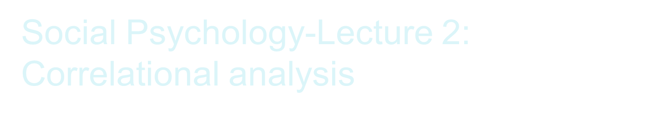
negative
positive
no relationship

Slide 16
Social Psychology-Lecture 2:
Nonexperimental Strengths
Whether 2 variables are related
If some phenomena is predictable based on knowledge of another variable
If variables are non-causal

Slide 17
Social Psychology-Lecture 2:
Reasons for noncausal relations
Direction of relationship is impossible to determine (TV→Agg. Or Agg.→TV?)
Possible 3rd variable problem (e.g., abuse)

Slide 18
Social Psychology-Lecture 2: Experimental Method - Signature
Control over the Independent Variables
Random assignment of the participants to conditions

Slide 19
Social Psychology-Lecture 2:
How to conduct an Experiment
Design materials and procedures to manipulate the IVs
Choose a sample and randomly assign them to the different conditions
Measure the effects of the IVs on the DVs
Generalize the results from the laboratory to life

Slide 20
Social Psychology-Lecture 2:
Strengths/weaknesses of an Experiment
Strengths
  Can determine causal relationships
Weaknesses
  Procedures can affect our ability to generalize from the lab to the real world
  Mundane realism vs experimental realism

Slide 21
Social Psychology-Lecture 2:
Major Theoretical Perspectives
Learning Theory
Consistency/Balance Theory
Attribution theory
Exchange and Equity Theory

